Slide 1

MINI PROJECT(2025-2026)
Distributed Denial of Service (DDoS) Attack Detection and Mitigation Using Machine Learning (ML) and Deep Learning (DL)
HEMANTH KUMAR B 24Q95A0512
B KARTHAR 23Q91A05D9
B UMA MAHESHWAR REDDY 23Q91A05D8
CH JAGADEESH 23Q91A05E3
Under the guidance of
Mr. N. BALARAMAN
MALLA REDDY COLLEGE OF ENGINEERING
Department of Computer Science and Engineering (Approved by AICTE- Permanently Affiliated to JNTU-Hyderabad) Accredited by NBA &NAAC, Recognized section2(f) &12(B) of UGC New Delhi ISO 9001:2015 Certified Institution Maisammaguda, Dhulapally (Post via Kompally) Secunderabad-500100

Slide 2
Distributed Denial of Service Attack Detection & Mitigation
Using Machine Learning & Deep Learning in Internet of Things

Slide 3
Abstract
This system detects and mitigates DDoS attacks in IoT environments using Machine Learning (ML) and Deep Learning (DL) techniques. It employs lightweight models such as XGBoost and Convolutional Neural Networks (CNN) to ensure efficient performance. The model achieves over 95% accuracy using the IoT23 dataset. It supports real-time detection through a Flask-based web application and can automatically block attacker IP addresses via a firewall. The system is evaluated using key performance metrics including accuracy, precision, recall, and F-score, and it provides an efficient and scalable solution for enhancing IoT security.

Slide 4
Introduction
The rapid growth of IoT devices has improved many applications but also increased security risks. Due to limited resources, these devices are vulnerable to DDoS attacks, which disrupt services by flooding networks. Traditional methods fail to detect modern attacks, creating a need for intelligent and real-time detection and mitigation solutions.

Slide 5
Existing System
Existing IoT security systems use antivirus, rule-based, and basic ML methods to detect DDoS attacks. These approaches are not suitable for IoT due to limited resources and evolving attack patterns.
Drawbacks:
Cannot detect unknown/zero-day attacks
High false positives
Requires high computational resources
Slow response due to cloud dependency
Poor scalability in large IoT networks

Slide 6
Proposed System
The proposed system uses Machine Learning (XGBoost) and Deep Learning (CNN) to detect DDoS attacks in IoT networks. It is trained on the IoT23 dataset and provides real-time detection using Flask, automatically blocking attacker IPs through firewall rules. The system achieves >95% accuracy and is designed for resource-constrained IoT environments.
Advantages:
High detection accuracy (>95%)
Detects both known & unknown attacks
Reduced false positives
Real-time detection & response
Scalable for large IoT networks
Efficient & automatic mitigation

Slide 7
Algorithms & Technologies Used
Algorithms
1.XGBoost (Machine Learning)
→ Fast and accurate classification of DDoS attacks
2.CNN (Convolutional Neural Network - Deep Learning)
→ Detects complex attack patterns
Technologies & Tools
Python → Main programming language
Jupyter Notebook → Model training & testing
Flask → Web application for real-time detection

Slide 8
System Architecture :
Data Collection: Collects network traffic data from IoT devices.
Preprocessing: Cleans and converts data into suitable format for analysis.
Model Training: Trains ML/DL models to learn attack patterns.
Detection: Identifies whether incoming traffic is normal or malicious.
Mitigation: Blocks attacker IP and prevents further attacks.

Slide 9
Model Training
1.Dataset (IoT23)
Input data for training
2.Data Preprocessing
Convert:
  Non-numeric → Numeric
Clean data
Split features:
  X (input features)
  Y (target labels)
3.Train-Test Split
80% → Training
20% → Testing

Slide 10
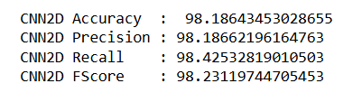
4.Model Training
ML Model → XGBoost (Existing)
DL Model → CNN (Proposed)
5.Trained Model
Both models are trained
6.Prediction
Use test data (X_test)
Predict output (Y_test)
7.Performance Evaluation
Metrics:
  Accuracy
  Precision
  Recall
  F1-score

Slide 11

This shows the web interface of the DDoS detection system where users can upload test data. It is built using HTML/CSS and Flask. It provides an easy way to interact with the model.

Slide 12
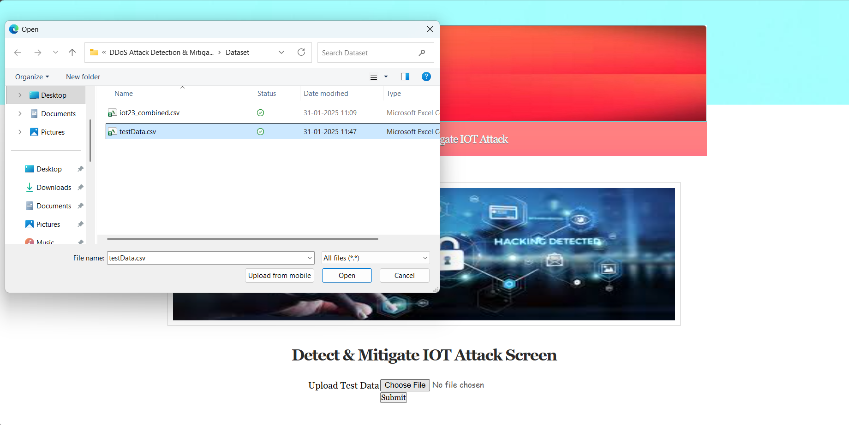
This shows the file upload process where the user selects a CSV dataset (like testData.csv). The selected file is given as input to the system for analysis.

Slide 13
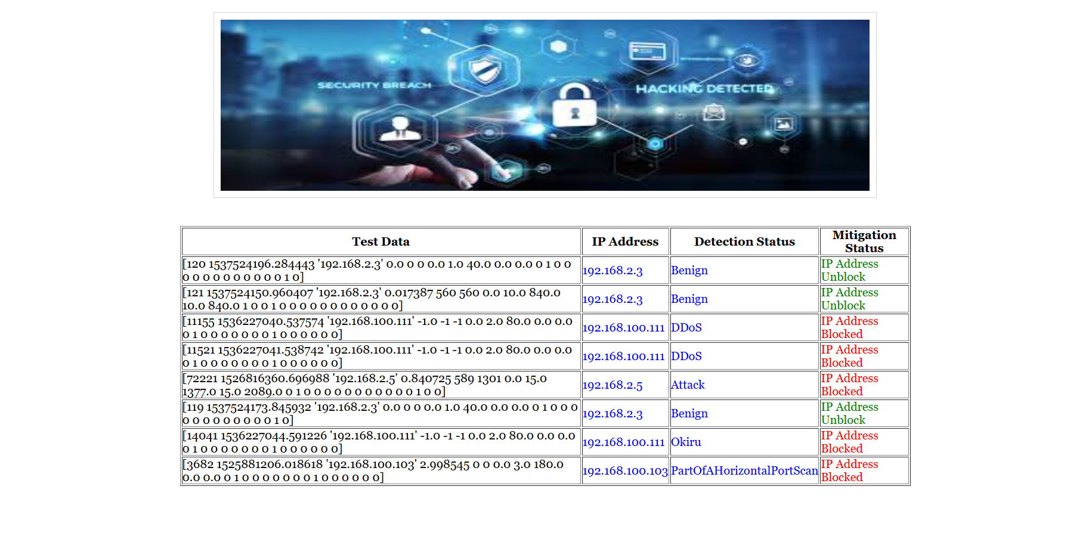
This shows the output results where the system displays detection status (Benign/Attack) and mitigation status. If an attack is detected, the IP address is automatically blocked.

Slide 14
SYSTEM REQUIREMENTS:
HARDWARE REQUIREMENTS:
Processor - Intel core i3(Min)
RAM - 8 GB (min)
Hard Disk - 500 GB
Key Board - Standard Windows Keyboard
Mouse - Two or Three Button Mouse
Monitor - SVGA
SOFTWARE REQUIREMENTS:
Operating system : Windows 7 Ultimate.
Coding Language : Python.
Front-End : Python.
Back-End : Django-ORM
Designing : Html, CSS, JavaScript.
Data Base : MySQL (WAMP Server).

Slide 15
Conclusion
DDoS attacks pose a serious threat to IoT networks due to their limited resources and security vulnerabilities. Traditional methods are not effective in detecting modern and evolving attacks. The proposed system using machine learning and deep learning provides high accuracy, reduces false positives, and enables real-time detection with automatic mitigation. Overall, it offers a scalable and efficient solution to enhance the security and reliability of IoT environments.

Slide 16
REFERENCES
2018
Doshi et al. – ML-based DDoS detection for IoT (IEEE SPW)
2018
Meidan et al. – Deep autoencoder-based botnet detection (IEEE Pervasive Computing)
2020
Tian et al. – Survey on DDoS detection in SDN (Security & Communication Networks)
2021
Kumar et al. – Hybrid ML approach for IoT botnet detection (IJISP)

